Slide 1
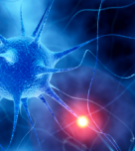
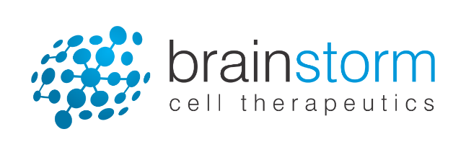
Ralph Kern MD MHSc.
Chief Operating Officer and Chief Medical Officer
September 2018
BrainStorm Cell Therapeutics
NASDAQ: BCLI
March 22, 2018

Slide 2
Forward Looking Statement
Statements in this announcement other than historical data and information constitute "forward-looking statements" and involve risks and uncertainties that could cause BrainStorm Cell Therapeutics Inc.'s actual results to differ materially from those stated or implied by such forward-looking statements. Terms and phrases such as "may", "should", "would", "could", "will", "expect", "likely", "believe", "plan", "estimate", "predict", "potential", and similar terms and phrases are intended to identify these forward-looking statements. The potential risks and uncertainties include, without limitation, risks associated with BrainStorm's limited operating history, history of losses; minimal working capital, dependence on its license to Ramot's technology; ability to adequately protect the technology; dependence on key executives and on its scientific consultants; ability to obtain required regulatory approvals; and other factors detailed in BrainStorm's annual report on Form 10-K and quarterly reports on Form 10-Q available at http://www.sec.gov.
These factors should be considered carefully, and readers should not place undue reliance on BrainStorm's forward-looking statements. The forward-looking statements contained in this press release are based on the beliefs, expectations and opinions of management as of the date of this press release. We do not assume any obligation to update forward-looking statements to reflect actual results or assumptions if circumstances or management's beliefs, expectations or opinions should change, unless otherwise required by law. Although we believe that the expectations reflected in the forward-looking statements are reasonable, we cannot guarantee future results, levels of activity, performance or achievements.
Notes:
Safe harbor statement

Slide 3
Successfully Leveraging Core Capabilities
Manufacturing Excellence
NurOwn Cryopreservation
Manufacturing Capabilities
Strong Science
Cell and Disease biology
Industry CNS experience
Strategic Partnerships
California Institute for
Regenerative Medicine (CIRM)
Patient Focus
Patient Advocacy Leadership

Slide 4
Addressing High Unmet Need Across Neurodegenerative Disorders
 | Amyotrophic Lateral Sclerosis (ALS) | Parkinson’s Disease (PD) | Progressive Multiple Sclerosis (MS) | Alzheimer’s Disease (AD) | Huntington’s Disease (HD) | Autism Spectrum Disorder (ASD)
Global patients | 220,000 | 10,000,000 | 1,250,000 | 47,000,000 | 300,000 | 35,000,000
US patients | 30,000 | 1,000,000 | 500,000 | 5,000,000 | 30,000 | 3,500,000
Clinical study endpoints | ALSFRS-R SVC | UPDRS | EDSS MSFC | ADAS-COG CDR-SB MOCA | UHDRS | ADOS-G CARS GARS
Biomarkers | CSF MCP-1 CSF CHIT-1 CSF NfL | Dopamine transporter imaging (DAT EMA approved July 27, 2018) | MRI CSF sCD27 CSF CHIT-1 CSF NfL | CSF Tau CSF AB-42 CSF NfL PET | CSF NfL CSF Tau CSF mHTT | CSF BDNF CSF MCP-1

Slide 5
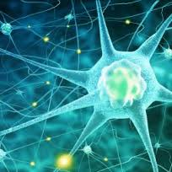
Parkinson’s Disease-6OHDA model
NurOwn® Preclinical Studies
Multiple Sclerosis-EAE model
Huntington’s Disease-QA model
ALS-SOD1 model
Autism-Mouse BTBR model

Slide 6
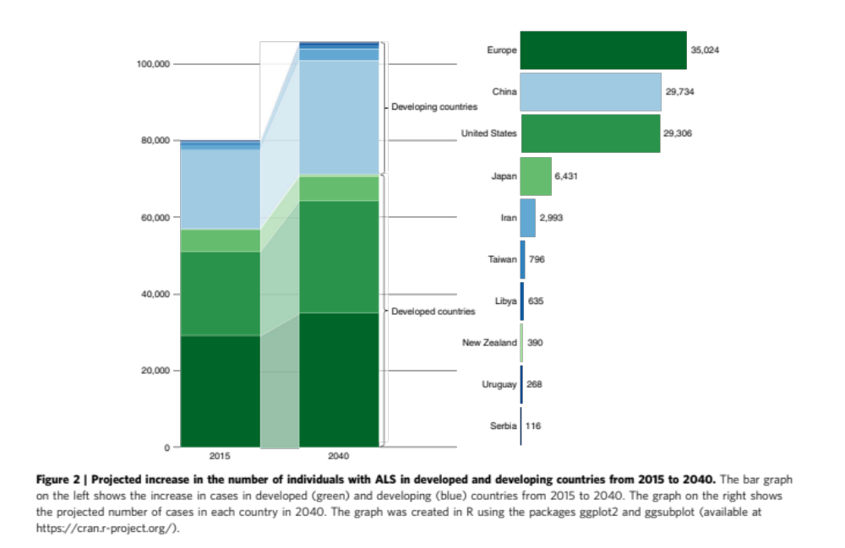
Global Prevalence of ALS is Increasing (2015-2040)
Nature Communications, 2016.

Slide 7
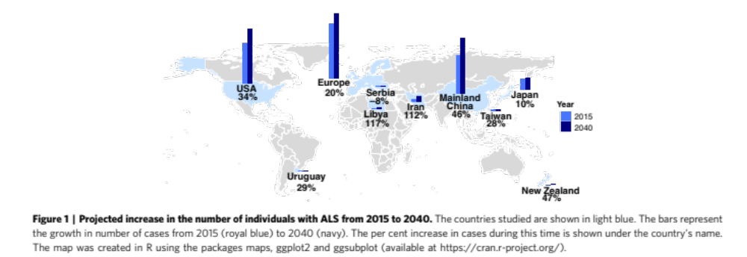
Global Incidence of ALS is Increasing (2015-2040)
Nature Communications, 2016.

Slide 8
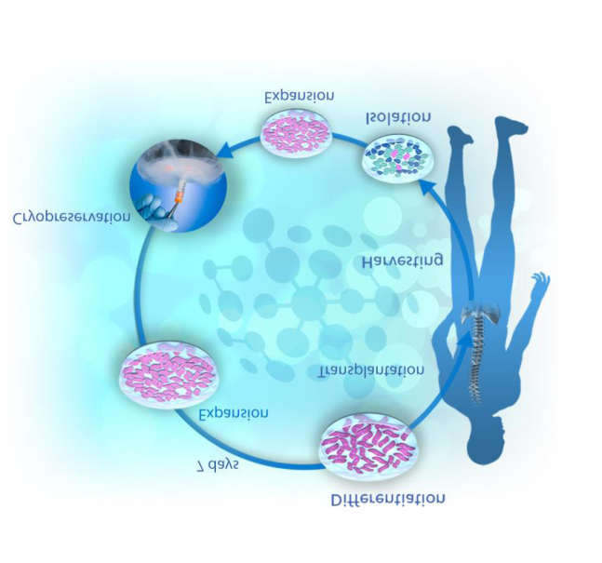
NurOwn® Manufacturing Process
NurOwn® MSC derived from self
No donor antigens
MSCs are cryopreserved
Single bone marrow aspirate yields 2-3 years of dosing
Thawing MSC to injection
MSC-NTF 7 days
NurOwn® process is validated
Manufacturing and shipping processes validated

Slide 9
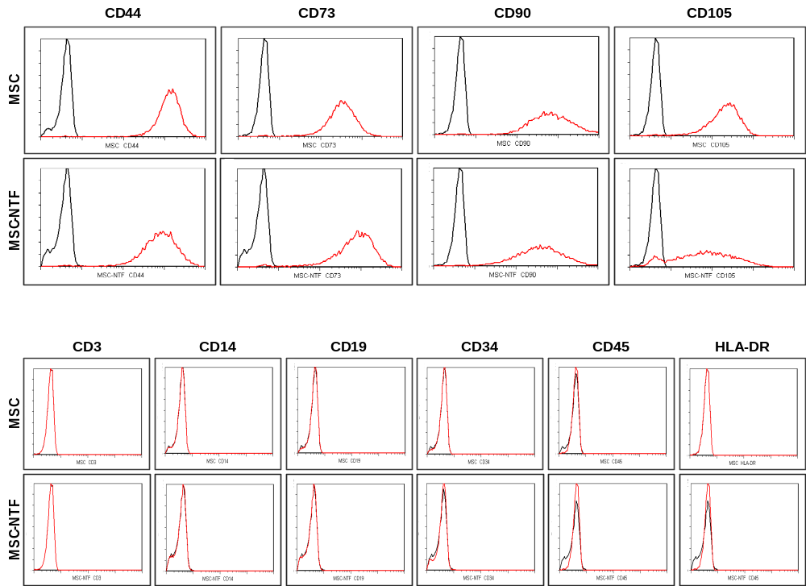
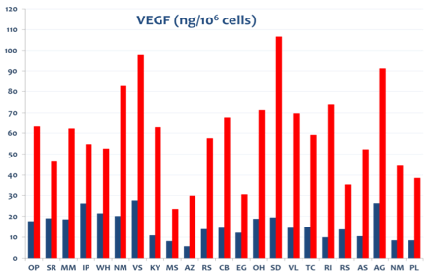
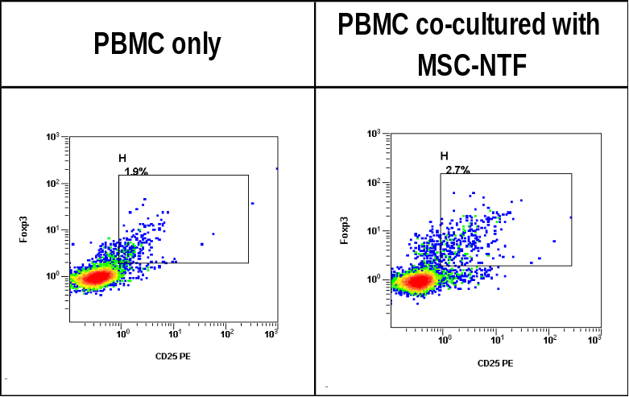
NurOwn®: Mesenchymal Stem Cells Secreting Neurotrophic Factors (MSC-NTF)
Preserved MSC cell surface markers
Enhanced Neurotrophic factor secretion
Consistent Immuno-modulation
CD markers
T regulatory cells (Tregs)
VEGF

Slide 10
NurOwn® ALS Development
2007
NurOwn® Early Development
2010
ALS
Phase 1/2a
2014
ALS
US Phase 2
2017+
ALS
US Phase 3
Repeat dosing
Rapid progressors
# of Study Participants
Notes:
Brainstorm has been developing NurOwn technology for 10 years and it has been in the clinic for 7 years
Encouraged by the phase 2 results we are about to begin the 4th ALS clinic study and the second in the US
The phase 3 program will be conducted in 6 top US ALS sites
We have recently received a 16M grant from CIRM, the California Stem cell agency, to support this program.
We are hopeful to develop a disease modifying therapy for ALS that may halt the relentless progression of this terrible disease.
<next slide>

Slide 11
NurOwn® Phase 2 Study: Met Primary Safety Outcomes
Screening
(V1)
BMA
(V4)
Transplantation
(V5)*
End of Study
(V10)
-12-16 weeks
-3-5 weeks
0
24-36 weeks
(~ 3 months)
CSF Collection
(V5 and V6)
(~ 9-10 months)
Study Design
N=48 participants (16 per site)
Randomized 3:1
Blinded to allocation
No deaths or treatment related SAEs
No drop outs related to SAEs
Most common adverse events transient and mild/moderate severity and procedure related
Efficacy
ALSFRS-R
SVC
*IT 125M cells/4 ml and IM (R biceps and R triceps)
BMA: Bone Marrow Aspirations
Monthly visits

Slide 12
NurOwn® ALS Phase 3 Study Schema
Outcomes
ALSFRS-R responder analysis
ALSFRS-R change from baseline
SVC
Tracheostomy-free survival
CSF/biomarkers (7 samples over 6 months)
Safety
Inclusion
≤ 60 years
SVC > 65%
ALS ≤ 2 years
Exclusion
Edaravone
Ventilation
Feeding tube
Rapid progressors
MSC-NTF (n=100)
Randomization
Bone Marrow Aspiration
Placebo (n=100)
Pre-Treatment
Treatment (0, 8, 16 weeks)
Post- Treatment (primary outcome 28 weeks)
ClinicalTrials.gov Identifier: NCT03280056

Slide 13
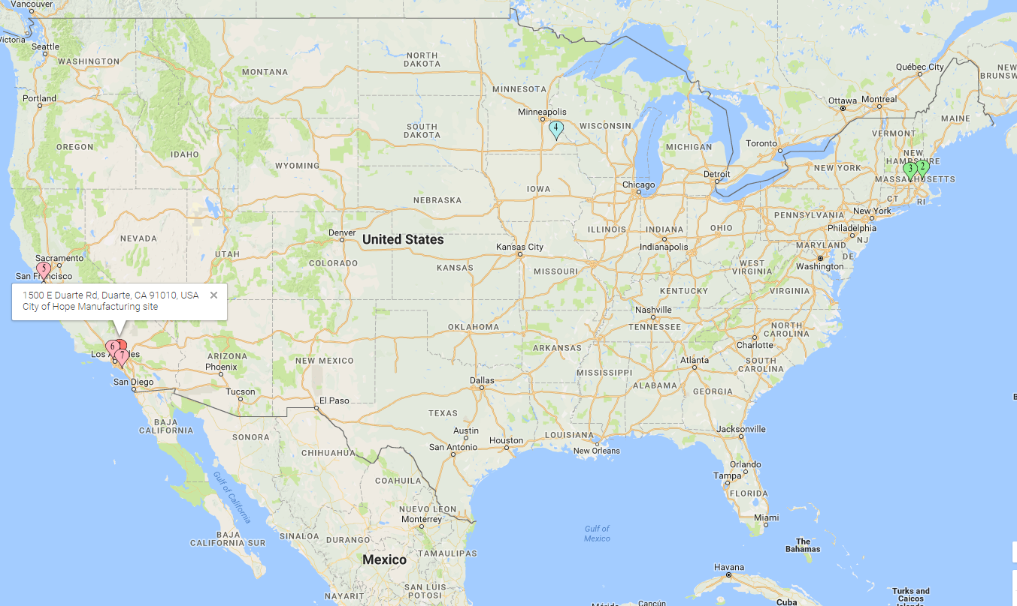
NurOwn® ALS Phase 3 Study Sites
Mayo Clinic (Rochester, MN)
MGH (Boston, MA)
California Pacific Medical Center,
(San Francisco, CA)
UMass (Worchester, MA)
Cedar Sinai
(Los Angeles, CA)
UC Irvine
(Los Angeles, CA)

Slide 14
NurOwn® ALS Phase 3 Study Timeline
Study Completion
Study Status
N=200 patients
1:1 randomization
Enrollment completed by Mid-2019
Top-line data mid 2020
Study duration of 11.5 months
7 months post-first transplantation
* Supported by $16M CIRM CLIN-2 grant
ClinicalTrials.gov Identifier: NCT03280056

Slide 15

NurOwn® Strong IP Portfolio
Patent Name/ Int. App. No. | Pending Jurisdictions | Allowed Jurisdictions | Granted Jurisdictions | Expiry Date
ISOLATED CELLS AND POPULATIONS COMPRISING SAME FOR THE TREATMENT OF CNS DISEASES/PCT/IL2006/000699 | US |  | Europe, US | 2030
MESENCHYMAL STEM CELLS FOR THE TREATMENT OF CNS DISEASES PCT/ IL2009/000525 |  | Hong Kong | US, Europe, Israel | 2032
METHODS OF GENERATING MESENCHYMAL STEM CELLS WHICH SECRETE NEUROTROPHIC FACTORS / PCT/IL2013/050660 | Europe, Hong Kong, Israel, Canada, Brazil, Japan |  | US, Japan | 2038
METHOD OF QUALIFYING CELLS /PCT IL2015/050159 | US, Europe, Hong Kong, Israel, Canada, Brazil, Japan |  |  | 2040
Methods of treating ALS PCT/IL2017/050801 | PCT |  |  | 2042
15

Slide 16
Prepared
BrainStorm Cell Therapeutics
NASDAQ: BCLI
Thank You!
March 22, 2018

